Slide 1



Slide 2
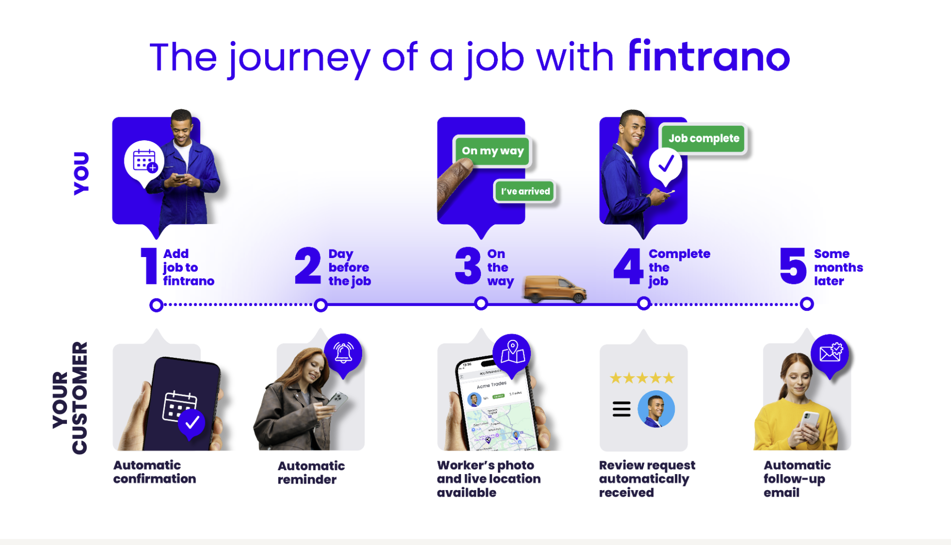

Slide 3
What are the results?

Slide 4
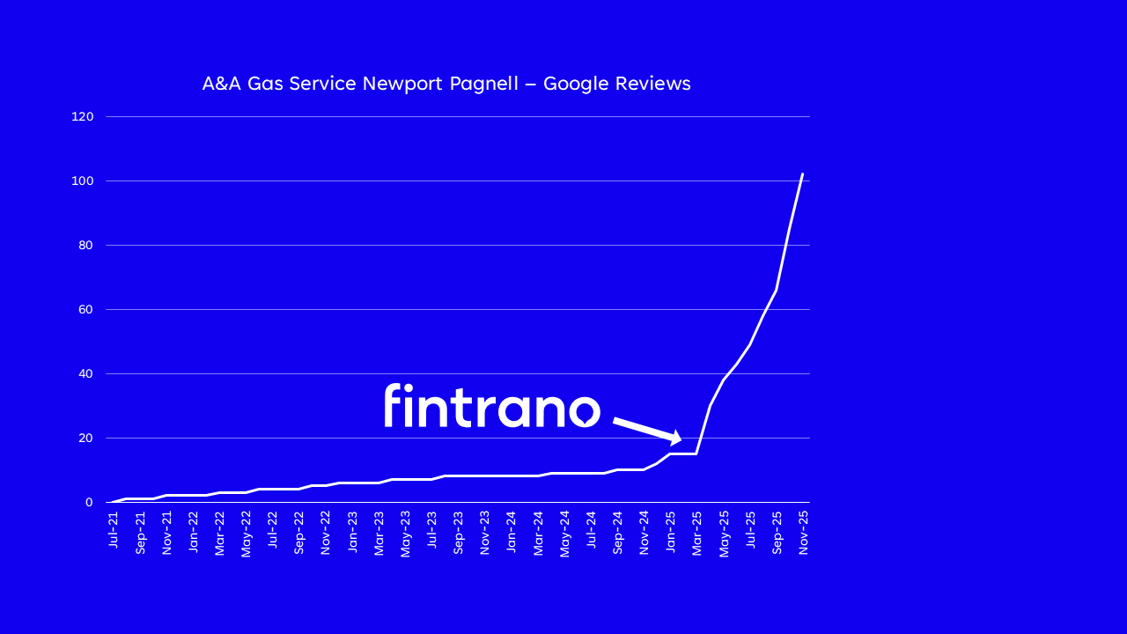


Slide 5
At a glance
80p per job
Unlimited users and customers
Minimum 25 jobs (£20+VAT) per month
Integrates with Google Calendar and Office 365
Simple job tracking, notes and attachments
Free trial
Free onboarding until the end of the year
Deliver Uber-style customer service with no extra effort
Get more 5-star reviews

Slide 6

Find out more at fintrano.com

